Slide 1
Summarization for News Data
Ramy Qranfal and Jake Carter

Slide 2
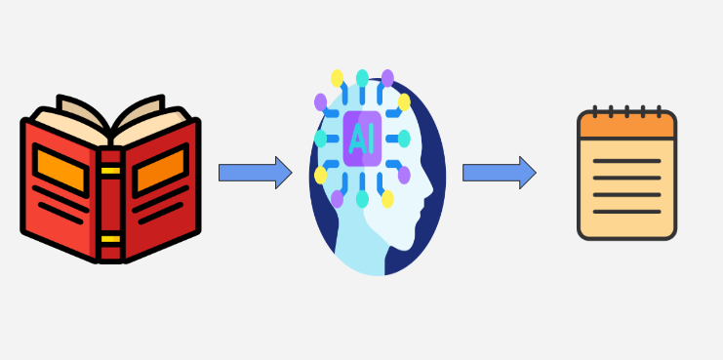
Introduction
AI-generated summaries often lack clarity and a natural, human-like writing style
Our solution is to fine-tune a model according to human-written summaries, hopefully resulting in a more human-like output
The dataset used includes CNN and Dailymail articles with author-written summaries
Our project goal is to provide concise and readable summaries of the news for people interested in the news but have little time to keep up with it

Slide 3

Problem
People are often interested in keeping up with current events, but this can be daunting
Many different news outlets with time-consuming shows and articles that the working person might struggle to keep up with
AI-generated summaries often lack clarity and a natural, human-like writing style
This lack of a human personality could put many people off of AI news as it appears stale and lifeless

Slide 4
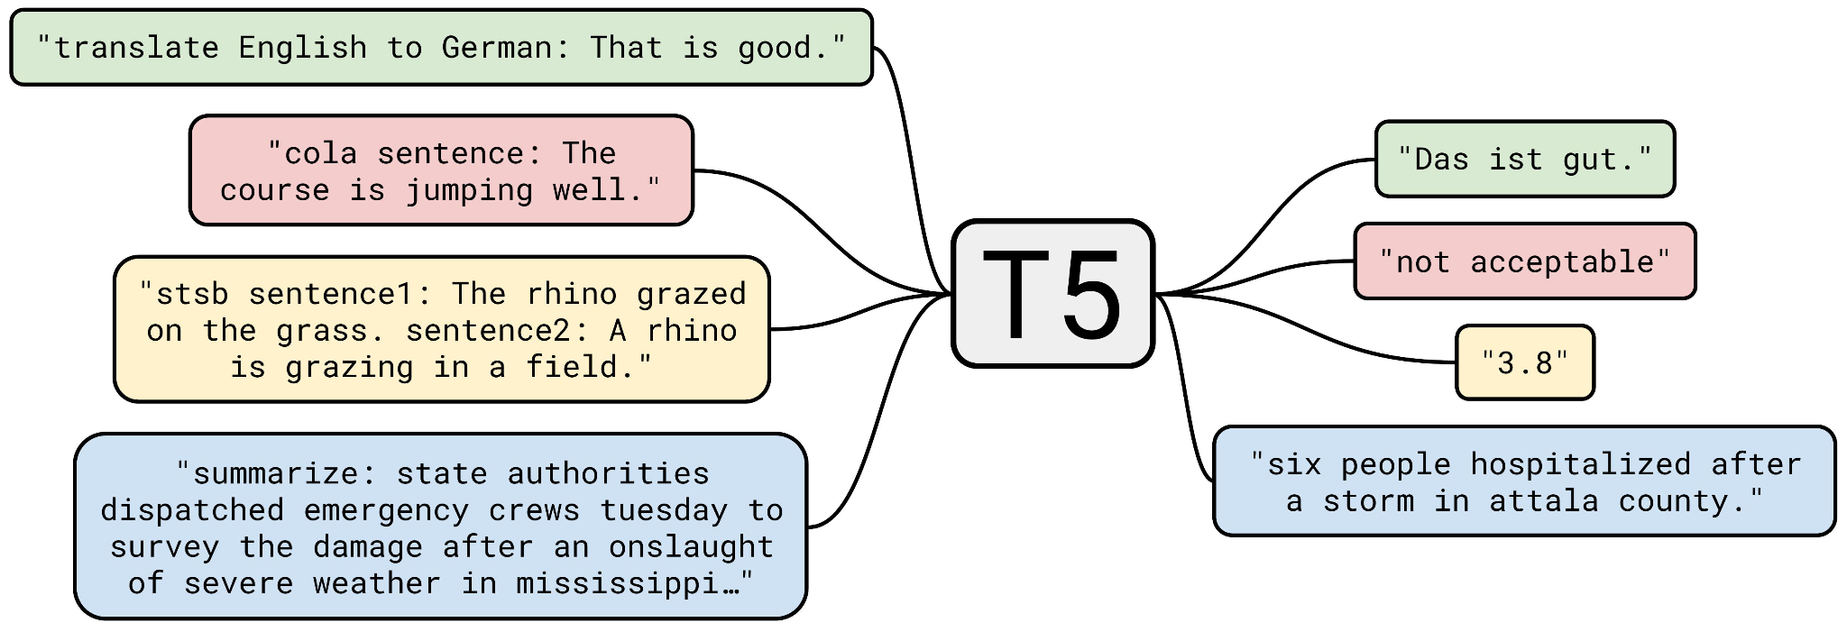
Pretrained LLM
Our chosen model is Google's T5-base
The T5 models are designed for text-to-text tasks. This makes them ideal for summarizations
The unsupervised pretraining of the T5 reduces overfitting and enhances task adaptability
The T5-base model was chosen for its balance between performance and resource cost
T5-small is less resource-intensive but results in lower performance
T5-large has higher performance at the cost of more computational resources

Slide 5

Methodology
Steps while utilizing the pretrained T5-base model as the base:
Loaded dataset and T5’s tokenizer
Sampled the large dataset for fine tuning
Tokenize text
Create a scoring system using the ROGUE score
Set parameters and training weights
Send the model, scoring metrics, and dataset to the trainer
Begin training to fine-tune the model

Slide 6
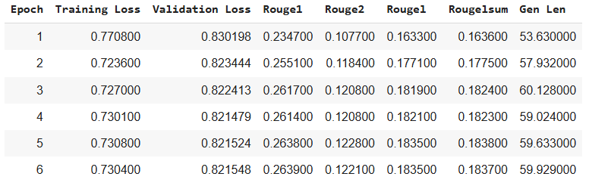
Results (Final ROUGE Scores)
ROUGE-1: 26.38% (Originally 23.47%)
Shows the model grasps key vocabulary and context
ROUGE-2: 12.28% (Originally 10.77%)
Demonstrates the model’s ability to be logical
ROUGE-L: 18.35% (Originally 16.33%)
Shows the model’s ability to retain and structure sentences
ROUGE-Lsum: 18.38% (Originally 16.36%)
Measurement for how the model keeps the overall structure of the content

Slide 7
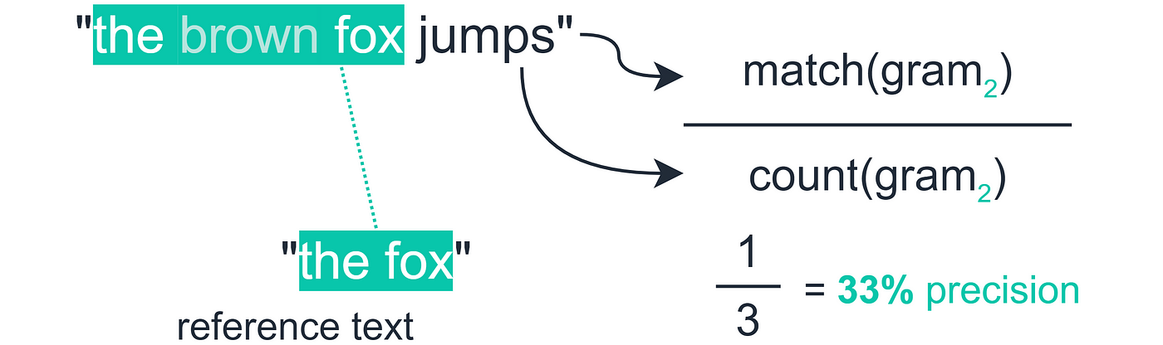
Accuracy
ROUGE scores steadily increased across epochs
Improved unigram and bigram coverage and with stronger summary structure
Generated summaries became longer and more detailed as training progressed (average length went from 53 to 60 tokens).
Strong signs of improvement based on 10,000 samples on the T5-base model

Slide 8
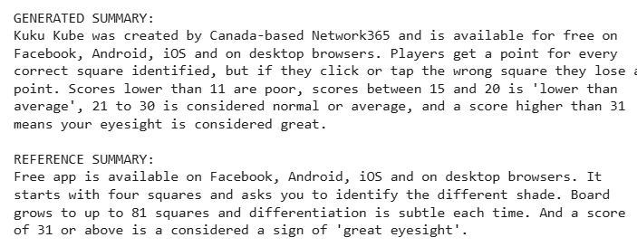
Examples

Slide 9

Analysis
T5-base shows a strong ability to produce human-like output on a limited dataset
ROUGE scores show a continually improving similarity to human output
Results could be improved on the T5-large model with a larger size of training samples
The model showed solid improvement in the first 3 epochs, while the final 3 epochs had minimal gains indicating convergence.

Slide 10

Conclusion
Fine-tuned the T5-base model using human-written summaries of articles
Accomplished via smart sampling, parameter adjustments, and preprocessing.
Steadily improving ROUGE scores show this model can achieve strongly human-like summaries

Slide 11

Thank you!

